Slide 1
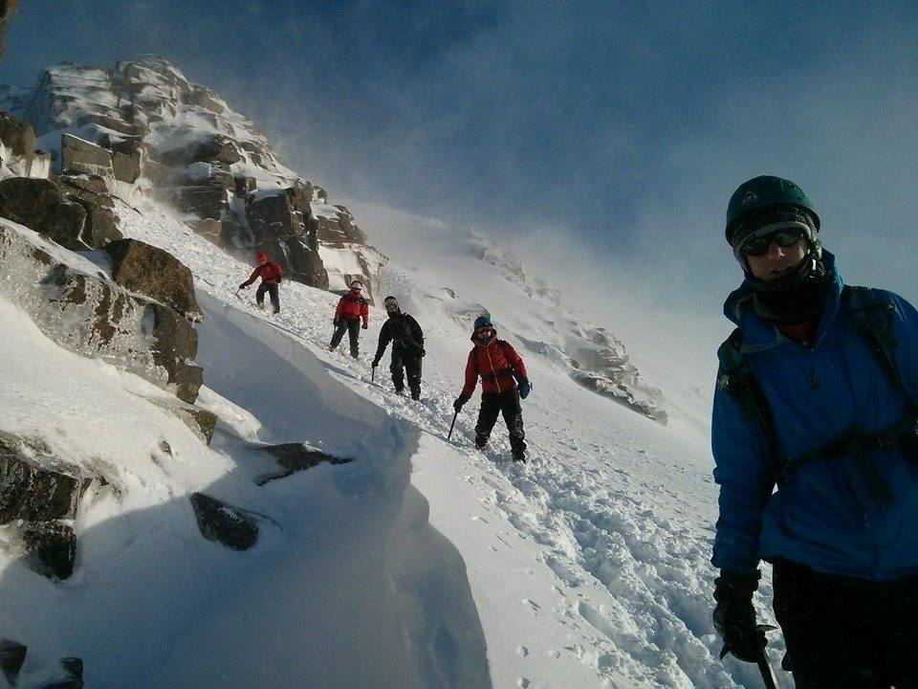
Snow and Ice 2018
Scottish Highlands in Winter
Winter Mountain Skills, Winter Hill Walking, Expeditions.
Bonus activities: Winter Climbing, Downhill Skiing, Cross Country Skiing, Snowholes.
Closing Date 10th January
More skills. More challenge. More adventure. More fun.
9th – 14th February
Apply now – first come first served.
£40 deposit, £260 in total.
Explorers, Network, Leaders.
http://www.westlancsscouts.org.uk/snow-and-ice

